Slide 1
Image-Text Matching with Nosiy Labels
Kun Zhang
8/19/2022

Slide 2
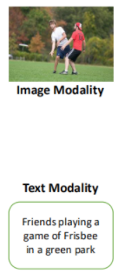
Introduction : Image-Text Matching
Task & Goal：
How to accurately measure the similarity between visual and textual inputs?
Learning the correspondence of image and text. How to accurately align shared semantics in image and text?
Challenges^{[1]}：
modality heterogeneity (semantic gap): different visual and textual feature spaces
_{image-text pairs}
_{Similarity Score}
_{S(image, text)}
_{Input}
_{Output}
<number>/24
[1] Re-ranking image-text matching by adaptive metric fusion, _{Pattern Recognition,} ₂₀₂₀

Slide 3
Introduction : Image-Text Matching
Existing image-text matching methods can be generally categorized:
One-to-One:
Using the whole image or the full text as a holistic feature to measure image-text similarity
Many-to-Many:
Exploiting all fine-grained word-region similarities to infer the overall image-text similarity
_{CMCAN}
_{AAAI}
₂₀₂₂
_{NAAF}
_{CVPR}
₂₀₂₂
_{SHAN}
_{IJCAI}
₂₀₂₁
_{MOTION}
_{AAAI}
₂₀₂₂
_{IMRAM}
_{CVPR}
₂₀₂₀
_{GSMN}
_{CVPR}
₂₀₂₀
_{RDAN}
_{IJCAI}
₂₀₁₉
_{DPRNN}
_{AAAI}
₂₀₁₉
_{SGM}
_{WACV}
₂₀₂₀
_{PFAN}
_{IJCAI}
₂₀₁₉
_{BFAN}
_{ACMMM}
₂₀₁₉
_{SAEM}
_{ACMMM}
₂₀₁₉
_{图文匹配}
_{部分代表工作}
_{SCAN}
_{ECCV}
₂₀₁₈
_{VSE++}
_{NeurIPS 2017}
_{LADDER}
_{AAAI2019}
_{VSRN}
_{ICCV 2019}
_{ADPT}
_{AAAI 2019}
_{DVSE}
_{CVPR 2015}
_{CMPM}
_{ECCV 2018}
_{PVSE}
_{CVPR 2019}
_{HAL}
_{AAAI}
₂₀₂₀
_{Best Pooling}
_{CVPR 2021}
_{HM-LSTM}
_{ICCV 2017}
_{2WayNet}
_{CVPR 2017}
_{MMCA}
_{CVPR}
₂₀₂₀
_{OFFLINE}
_{ECCV}
₂₀₂₀
_{Polynomial}
_{CVPR}
₂₀₂₀
_{NCR}
_{NeurIPS}
₂₀₂₁
_{CCR-CCS}
_{arxiv}
₂₀₂₁
_{DIME}
_{SIGIR 2021}
一对一语义匹配:完整文本和完整图像
_{多对多语义匹配:文本单词和图像区域}
<number>/13
注：
损失度量
Notes:
which requires external object detection tools pre-trained on large-scale datasets.
or salient regions and keywords

Slide 4
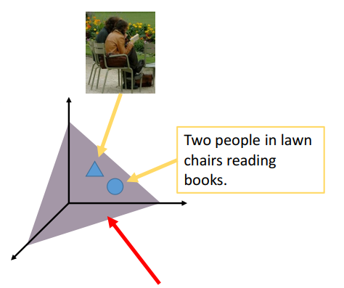
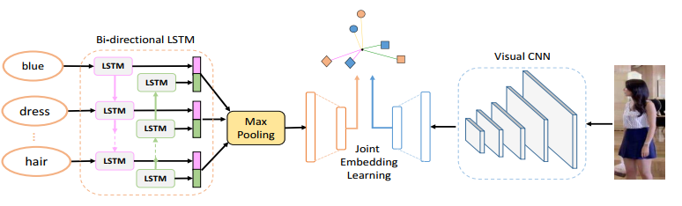
Introduction : Image-Text Matching
Existing approaches：
one-to-one approaches
focus on learning global correspondence
jointly project the whole image and text into a common latent space
designing specific networks and adding constraints ^{[2]}
Example ^{[3]}:
common space
Similarity S(image, text)
Calculated by:
Inner product
cosine value
etc.
_{text}
_{image}
[2] Adversarial cross-modal retrieval, _{ACM MM,} ₂₀₁₇
[3] Deep Cross-Modal Projection Learning for Image-Text Matching, ECCV, 2018
<number>/24
Notes:
without external object detection tools
语义嵌入
特征约束

Slide 5
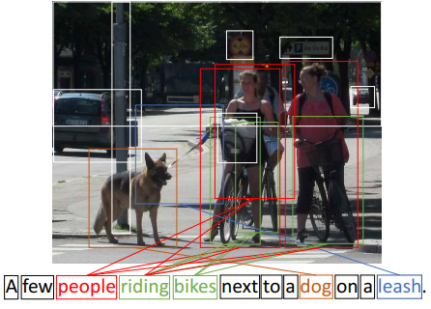
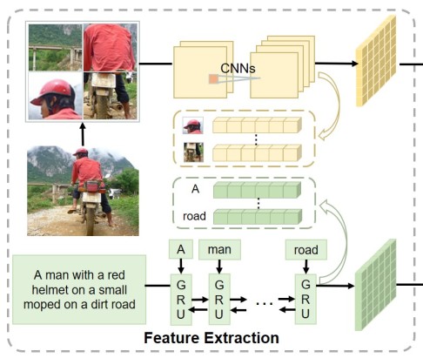
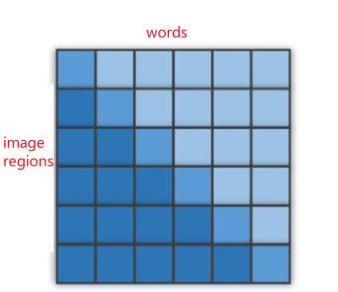
Introduction : Image-Text Matching
Existing approaches：
many-to-many approaches
focus on objects in the image and words in the text
local region-word correspondence
infer the global similarity of image-text pairs.
Example ^{[4]}:
_{S(image, text)}
_{Global} Similarity: aggregation similarity of all fragments of image and text
_{Similarity Matrix}
[4] Stacked Cross Attention for Image-Text Matching, ECCV, ₂₀₁₈
Focus Your Attention: A Bidirectional Focal Attention Network for Image-Text Matching, _{ACM MM,} ₂₀₁₉
<number>/24
Notes:
which requires external object detection tools pre-trained on large-scale datasets.
or salient regions and keywords

Slide 6
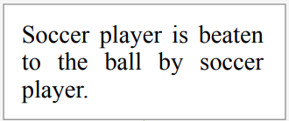
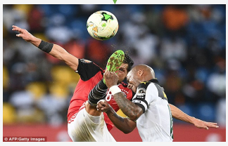
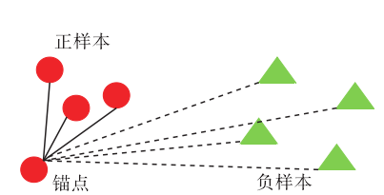
Introduction:
Image-Text Matching with noisy labels
Existing labels for matching learning
    _{matched (positive pair)}
    _{mismatched (negative pair)}
<number>/24

Slide 7
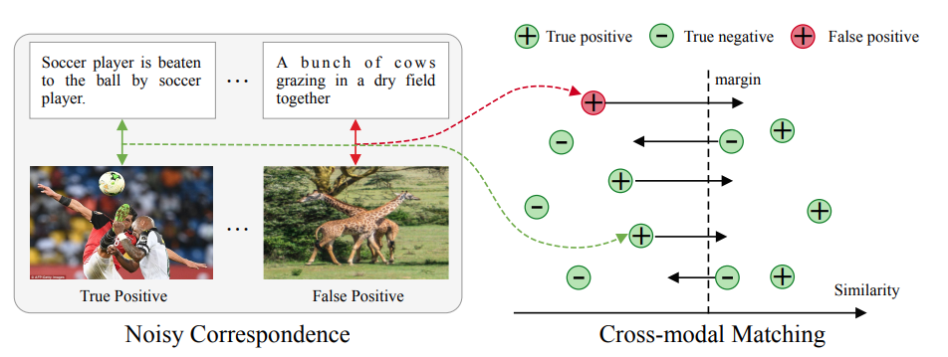
Introduction:
Image-Text Matching with noisy labels
Existing labels for matching learning
    _{matched (positive pair)}
    _{mismatched (negative pair)}
false positive pair
false negative pair
Noisy Correspondence
<number>/24

Slide 8
How to eliminate the Noise-Correspondence?
1) determine whether it is noise
_{2) the way to eliminate noise}
learning-with-noisy-correspondence-for-cross-modal-matching, NeurIPS, 2021
Ladder Loss for Coherent Visual-Semantic Embedding, AAAI, 2019
Adaptive Offline Quintuplet Loss for Image-Text Matching, ECCV, 2020
Is An ImageWorth Five Sentences? A New Look into Semantics for Image-Text Matching, arXiv, 2021
<number>/24
Notes:
which requires external object detection tools pre-trained on large-scale datasets.
or salient regions and keywords

Slide 9
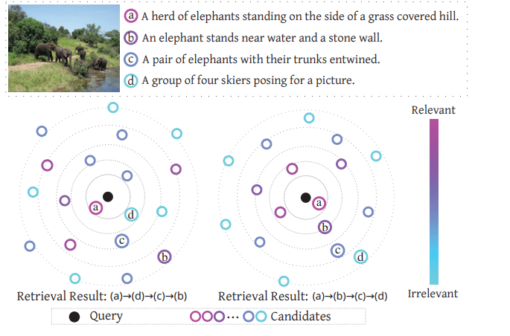

Ladder Loss for Coherent Visual-Semantic Embedding
1) determine whether it is noise
_{2) the way to eliminate noise}
image
text
text
<number>/24
Notes:
which requires external object detection tools pre-trained on large-scale datasets.
or salient regions and keywords

Slide 10

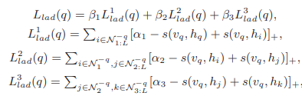
Ladder Loss for Coherent Visual-Semantic Embedding
1) determine whether it is noise
_{2) the way to eliminate noise}
image
text
text
<number>/24
Notes:
which requires external object detection tools pre-trained on large-scale datasets.
or salient regions and keywords

Slide 11
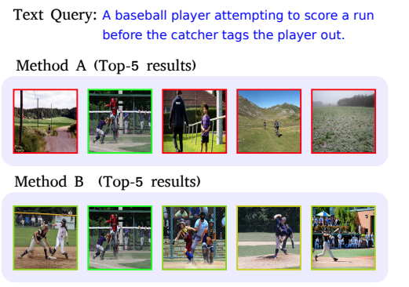

Is An ImageWorth Five Sentences? A New Look into Semantics for Image-Text Matching
1) determine whether it is noise
_{2) the way to eliminate noise}
image
text
CIDEr and SPICE
text
<number>/24
Notes:
which requires external object detection tools pre-trained on large-scale datasets.
or salient regions and keywords

Slide 12
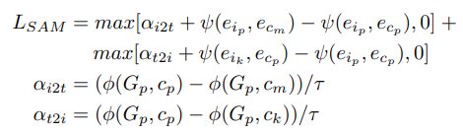
Is An ImageWorth Five Sentences? A New Look into Semantics for Image-Text Matching
1) determine whether it is noise
_{2) the way to eliminate noise}
image
text
CIDEr and SPICE
text
<number>/24
Notes:
which requires external object detection tools pre-trained on large-scale datasets.
or salient regions and keywords

Slide 13
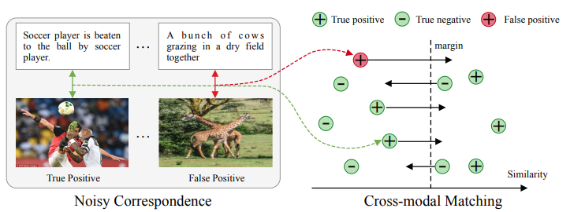

learning-with-noisy-correspondence-for-cross-modal-matching
1) determine whether it is noise
_{2) the way to eliminate noise}
<number>/24
Notes:
which requires external object detection tools pre-trained on large-scale datasets.
or salient regions and keywords

Slide 14
learning-with-noisy-correspondence-for-cross-modal-matching
1) determine whether it is noise
_{2) the way to eliminate noise}
<number>/24
Notes:
which requires external object detection tools pre-trained on large-scale datasets.
or salient regions and keywords

Slide 15
learning-with-noisy-correspondence-for-cross-modal-matching
1) determine whether it is noise
_{2) the way to eliminate noise}
Motivated by this, we utilize the difference of loss distribution between the clean samples and noisy samples to divide the training data like.
<number>/24
Notes:
which requires external object detection tools pre-trained on large-scale datasets.
or salient regions and keywords

Slide 16
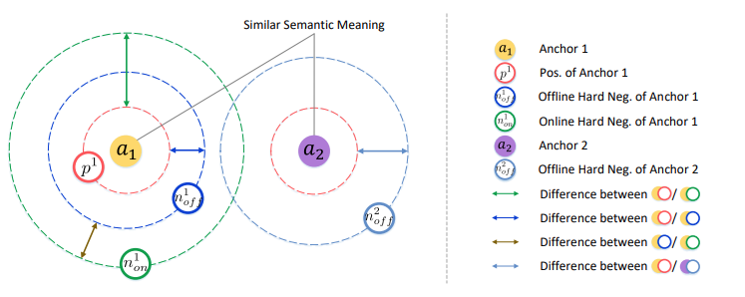
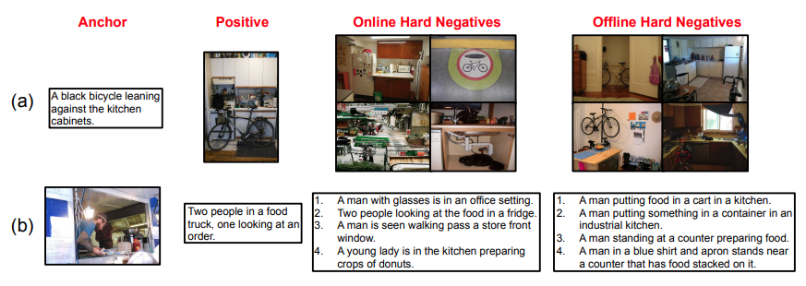
Adaptive Offline Quintuplet Loss for Image-Text Matching
1) determine whether it is noise
_{2) the way to eliminate noise}
Offline model
Training
<number>/24
Notes:
which requires external object detection tools pre-trained on large-scale datasets.
or salient regions and keywords

Slide 17
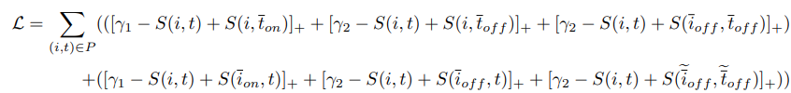
Adaptive Offline Quintuplet Loss for Image-Text Matching
1) determine whether it is noise
_{2) the way to eliminate noise}
Offline model
Two branch
Training
<number>/24
Notes:
which requires external object detection tools pre-trained on large-scale datasets.
or salient regions and keywords

Slide 18
Thanks
<number>/24

